Slide 1
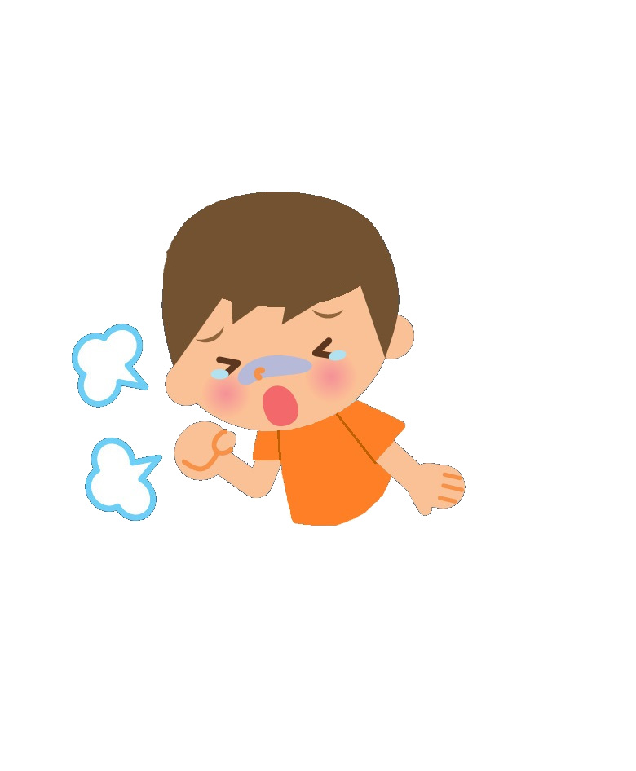
Notes:
This is Chris. Chris is sick and coughs badly.

Slide 2

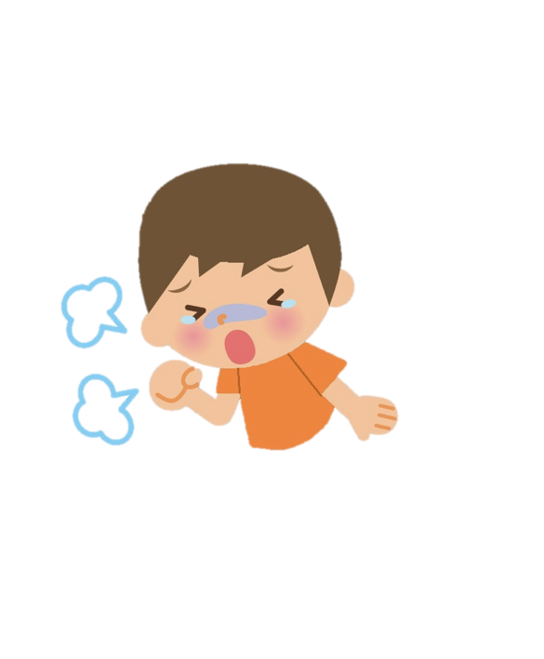
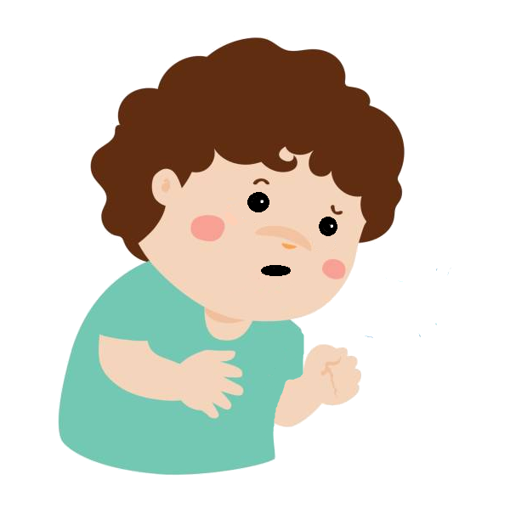
Notes:
When s/he is in his/her classroom, s/he coughs on her/his friend’s face. Chris’ friend says that now s/he could get sick because Chris coughed on his/her face.

Slide 3
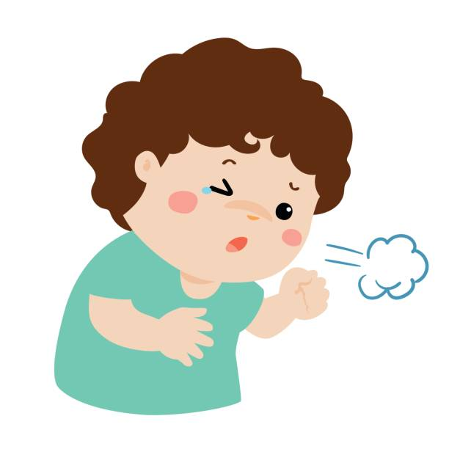
Notes:
Can that happen? Can Chris’ friend get sick just from being coughed on? Or can that not happen? Can Chris’ friend not get sick just from being coughed on?

Slide 4
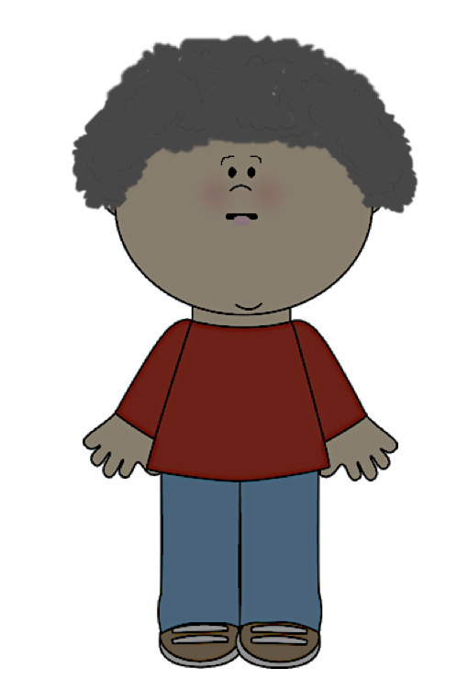


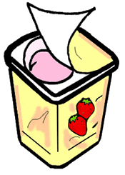

Notes:
This is Dana. Dana has a cold. S/he’s having a yogurt with her/his spoon.

Slide 5
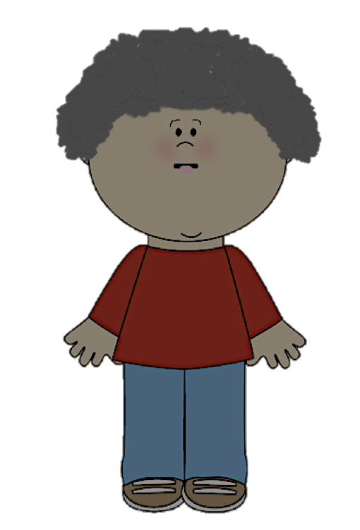
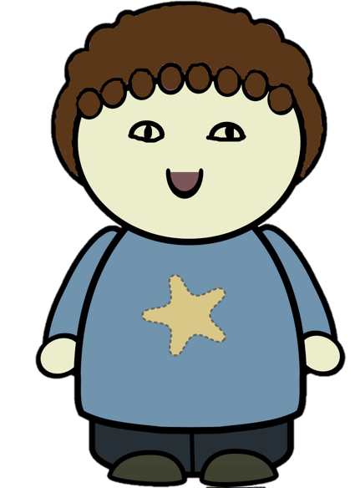
Notes:
Dana licks her/his spoon and offers her/his neighbor-friend some yogurt from her/his spoon. Dana’s neighbor says that s/he could get the cold because Dana licked her/his spoon and offered her/him some yogurt from the spoon.

Slide 6
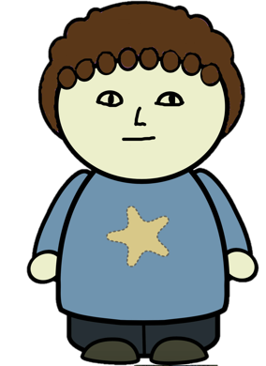

Notes:
Can that happen? Can her/his neighbor get the cold just from sharing a spoon with Dana while s/he has a cold? Or can that not happen? Can Dana’s neighbor not get the cold just from sharing a spoon with Dana who has a cold?

Slide 7
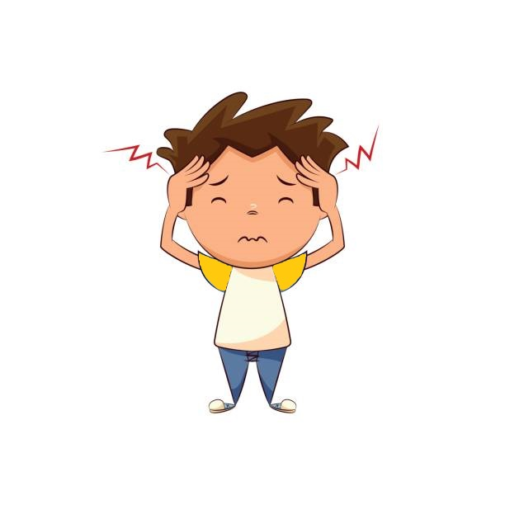

Notes:
This is Casey. Casey has flu and has a bad headache.

Slide 8


Notes:
Casey uses his/her classmate’s water bottle in school. Casey’s classmate says that s/he could get the flu because Casey used his/her water bottle.

Slide 9

Notes:
Can that happen? Can Casey’s classmate get the flu just by sharing a water bottle with Casey while s/he has the flu? Or can that not happen? Can Casey’s classmate not get the flu just by sharing a water bottle with Casey who has the flu?

Slide 10

Notes:
1. This is Riley. Riley has a cold, so s/he has a stuffy nose.

Slide 11
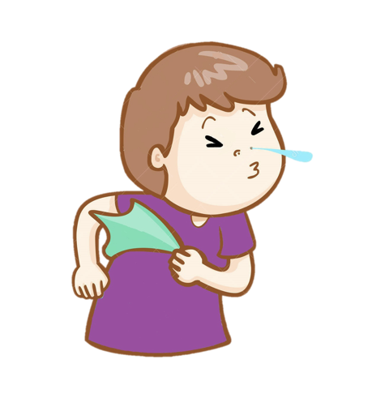
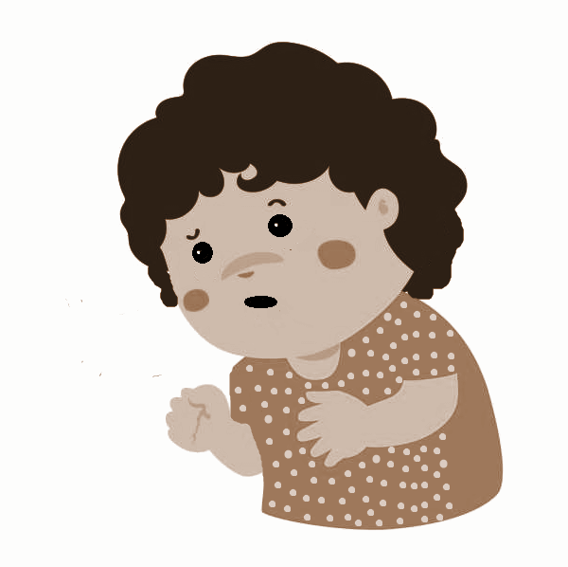
Notes:
Riley’s friend comes over to play with her/him for a little while. Riley sneezes onto her/his friend. Riley’s friend says that now s/he could get a cold because Riley sneezed onto her/him.

Slide 12
Notes:
Can that happen? Can Riley’s friend get a cold just from being sneezed on? Or can that not happen? Can Riley’s friend not get a cold just from being sneezed on?

Slide 13


Notes:
This is Jordan. Jordan has the flu, and s/he has a sore throat.

Slide 14

Notes:
2. Jordan’s cousin comes to her/his house to visit her/him. Jordan kisses her/his cousin when s/he sees her. Jordan’s cousin says that now s/he could get flu because Jordan kissed her.

Slide 15
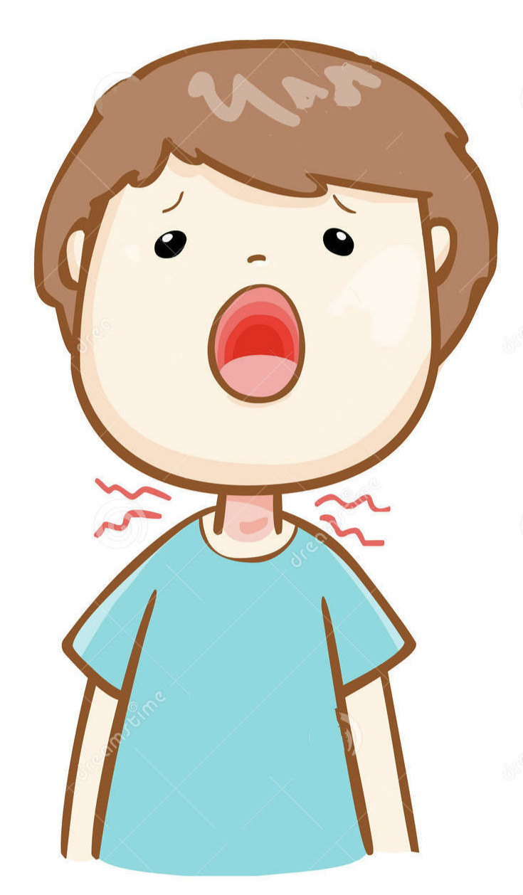
Notes:
Can that happen? Can Jordan’s cousin get flu just from being kissed by Jordan who has the flu? Or can that not happen? Can Jordan’s cousin not get the flu just from being kissed by Jordan who has the flu?

Slide 16
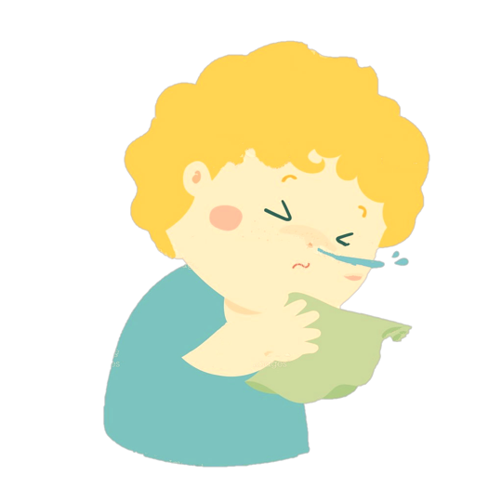
Notes:
4. This is Andy. Andy is sick and s/he has a running nose. Andy was invited to his/her friend’s party. Andy is sniffling a lot gets a tissue all wet with her runny nose.

Slide 17
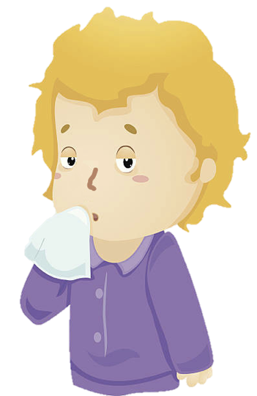
Notes:
Andy’s friend then uses the tissue to wipe his/her mouth. When Andy’s friend finds out that s/he had wiped her mouth with the runny nose tissue, s/he says that s/he could get sick because she touched the tissue.

Slide 18
Notes:
Can that happen? Can Andy’s friend get sick just from being touched by the runny nose tissue? Or can that not happen. Can Andy’s friend not get sick just from being touched by the runny nose tissue?

